Slide 1


Home Price Prediction in Ames, Iowa – Team 84
Team Members:
Reena Sahai: (RSahai6)
Jonathan Gerszberg (JGerszberg3)
Vignesh Thavamani Thenmozhi (VThenmozhi3)
Siddharth Gudiduri (SGudiduri3)

Slide 2

Team Members
Reena Sahai: (RSahai6)
Reena Sahai is a data quality analyst at a renowned US national bank with 14 years of experience working as a database developer and reporting analyst in various domains like education, healthcare, and finance. She got a Master’s degree in Computer science.
Jonathan Gerszberg (JGerszberg3)
Jonathan is a software developer at Siemens in Ann Arbor, MI. He got a BS at Rutgers University in Math and chemical engineering, and an MS at the University of Michigan in chemical engineering.
Vignesh Thavamani Thenmozhi (VThenmozhi3)
Vignesh is based out of Atlanta and has extensive experience in the Retail and Supply Chain Industry. He has a bachelor’s in Electrical and Electronics Engineering and a diploma in Business Management.
Siddharth Gudiduri (SGudiduri3)
Siddharth is an experienced engineer with a strong background in computer science and with 15 years of experience in Software Development Lifecycle (SDLC). He has solid hands-on experience from redesigning existing software to solving complex technical problems with an emphasis on object-oriented design and programming.

Slide 3

Ongoing Kaggle Competition

Slide 4
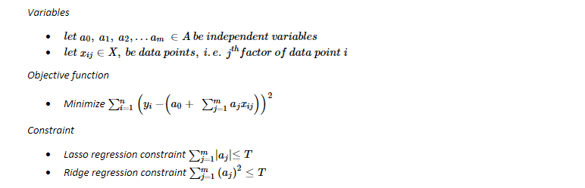
Problem Statement
Homes, that are geographically close, can have significantly varied prices. This research aims to gain key insight into what physical and environmental aspects of a home make it more or less expensive. With this understanding, it is the hope that a model can be created to predict the price of the home. This investigation will primarily focus on the Ames housing dataset, which was compiled by Dean De Cock, and the environment data from, the website, Neighborhood Scout.
The purpose of this project is to minimize the Mean Square Error (MSE) of the predicted sales price of the home vs the actual sales price of the home and to maximize 𝑹𝟐 (explainable variation). Formulating the above problem, some variables, and objective functions can be defined as follows:

Slide 5
Hypothesis
Does there exist a relationship between the dependent variable(Sale Price) and independent variable in dataset ? How does the number of bedroom, lot size and other attribute relate to Sale Price?

Slide 6
Data Analysis
Data Storage
Int64
Currency
Size
Object
Classification
Correlated Groups
Bedroom vs Sales price
Continue to Identify important features.*

Slide 7
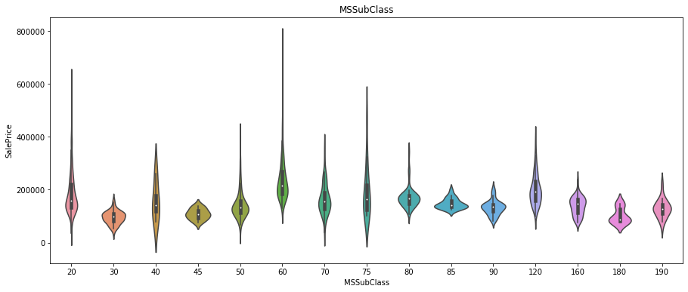
Correlation of Sale Price vs MS SubClass

Slide 8
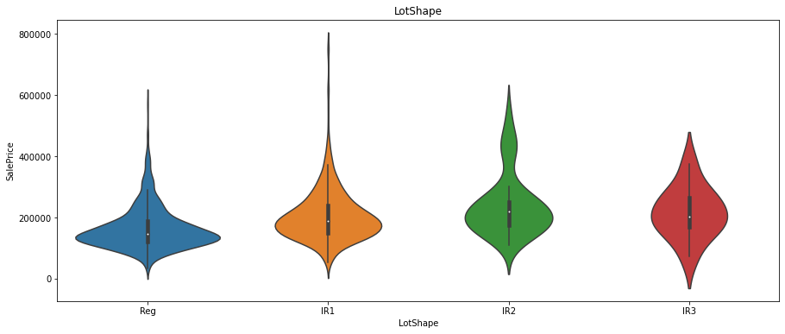
Correlation of Sale Price vs LotShape

Slide 9
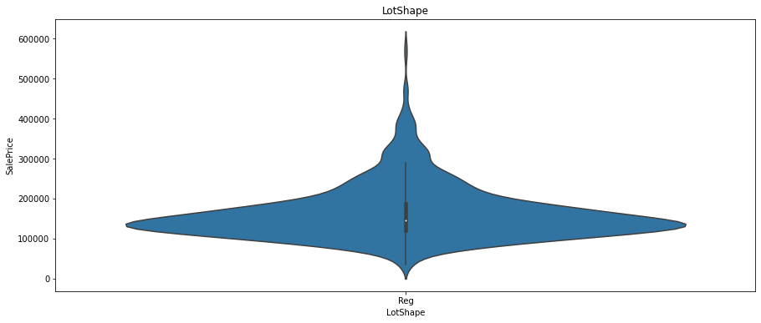
Correlation of Sale Price vs LotShape.Reg

Slide 10
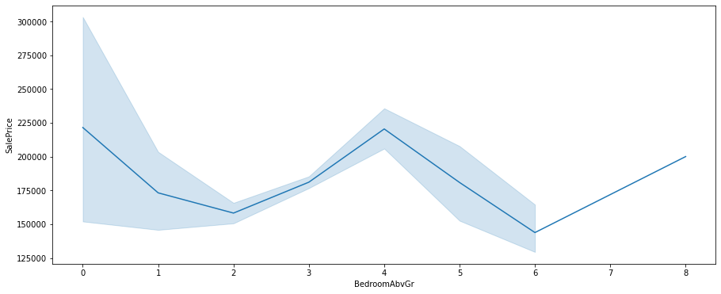
Correlation of Sale Price vs Bedroom

Slide 11
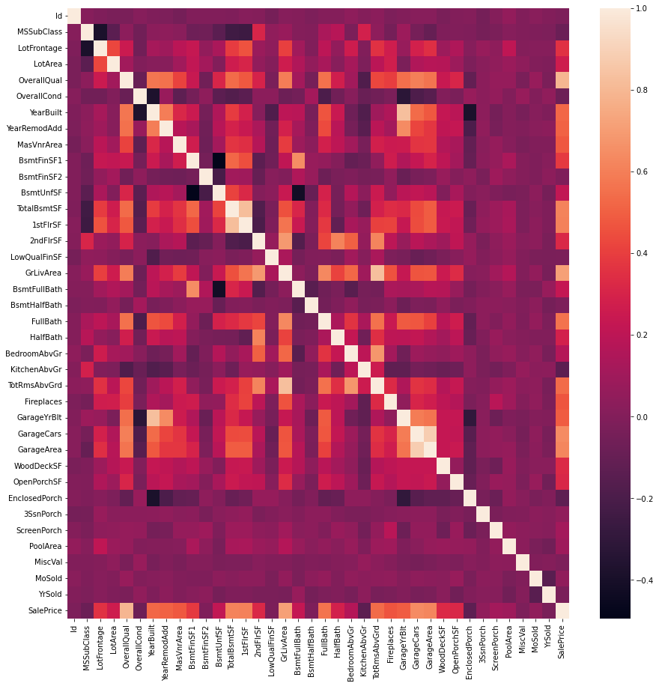
Correlation Matrix

Slide 12
Data Processing
Encoding Character Type
MS Zoning
Industrial, agriculture, commercial
Street Type
Paved, Gravel
Scaling Numeric type
Lot Area
Pool Area
Misc Value
Removing Pooled data
Remove Id, Year and other non-related features.

Slide 13
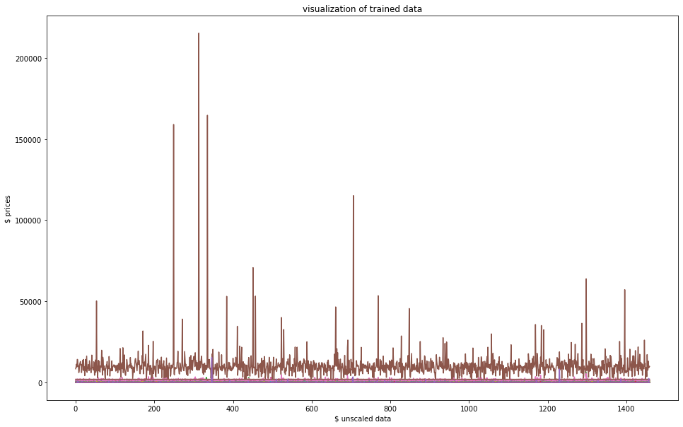
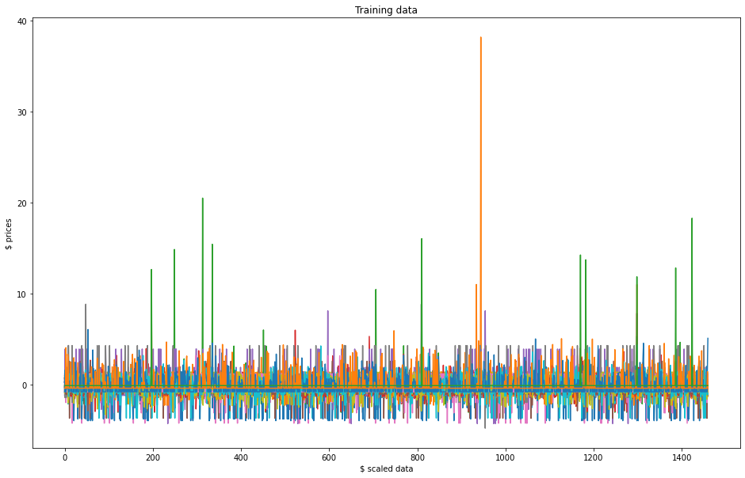
Data Processing

Slide 14

Curse of Dimensionality
Statistical models not able to compute accurate results.
Overfitting models
Ways to mitigate
Dimension reduction

Slide 15
Dimension Reduction Techniques
Principal Component Analysis(PCA)
Functional Principal Component Analysis(FPCA)
B-Splines
Lasso Regression
Removing Pooled data
Remove Id, Year and other non-related features.

Slide 16
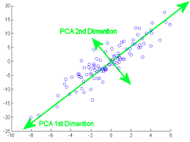
Principal Component Analysis(PCA)
PCA, reduction technique by weights being by variance such that majority of variance are captured by first few components. This performed by calculating eigenvalues and eigenvectors.
https://www.cs.cmu.edu/~elaw/papers/pca.pdf

Slide 17
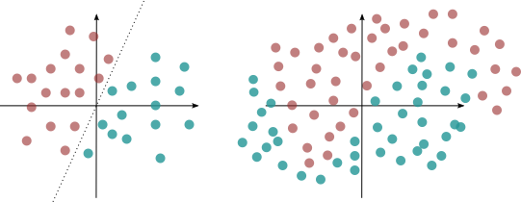
Kernel Principal Component Analysis(KPCA)
Same as PCA with respect to eigenvalue and eigenvectors, however non-linear methods(kernel operator) is used to capture variance in low dimensional subspace

Slide 18
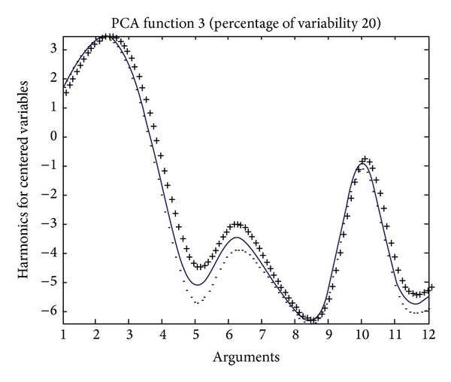
Functional PCA
Functional PCA, reduction technique where each point is a function input
Source:
https://www.psych.mcgill.ca/misc/fda/files/CRM-FPCA.pdf

Slide 19
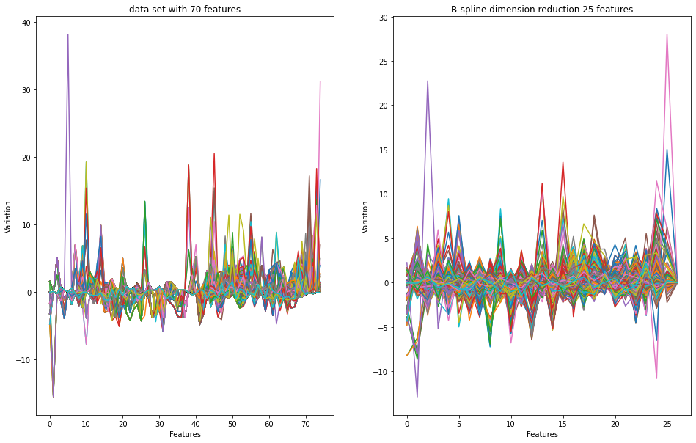
Functional Data Analysis

Slide 20
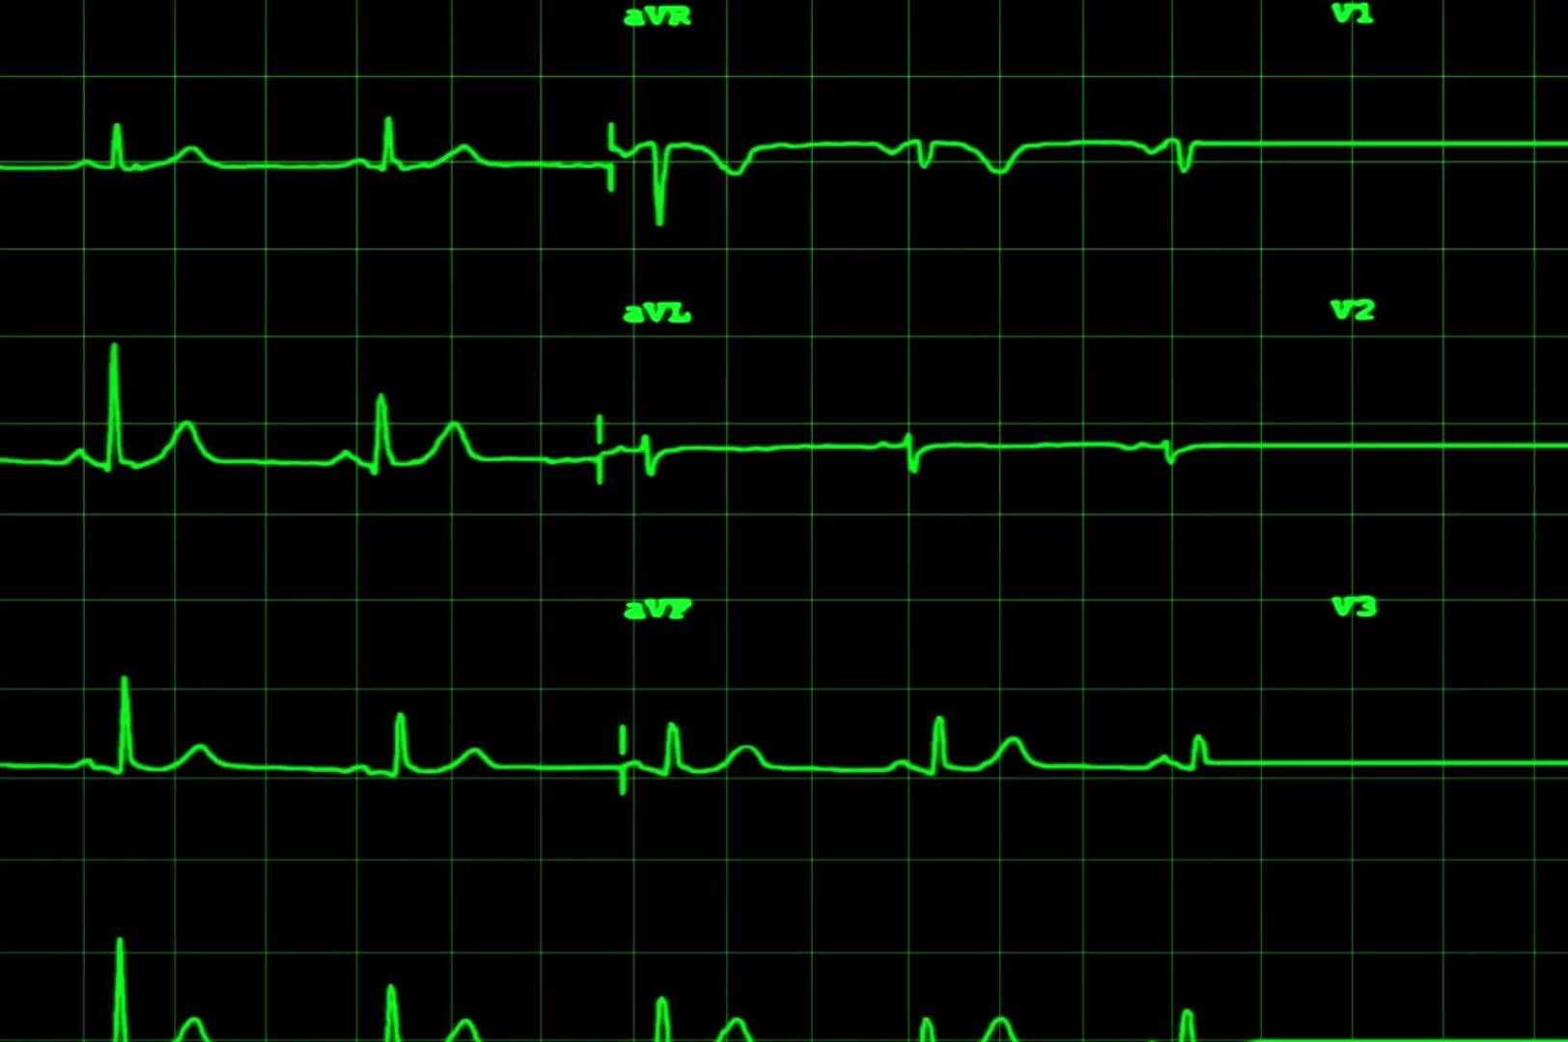
Statistical Models
Tree based models
Random Forest
AdaBoost
GradientBoost
Regression Models
Linear Regression
Ridge Regression
Lasso Regression
Adaptive Lasso Regression
Group Lasso

Slide 21
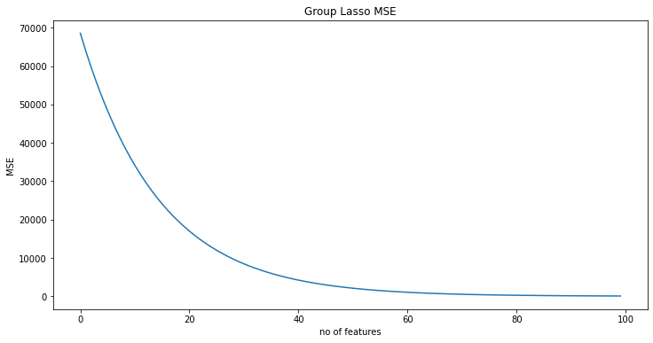
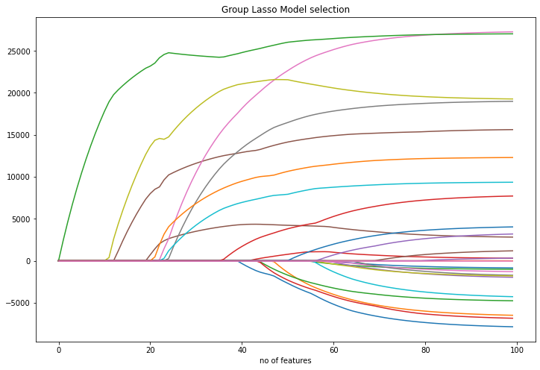
Group Lasso (MSE vs Feature selection)

Slide 22
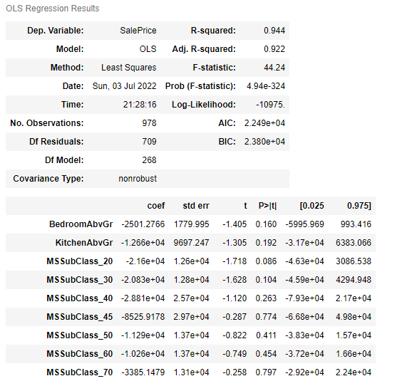
OLS Statistical Sample Results

Slide 23
Results using Tree based models W/80-20 training/test split
Model | R^2 | Mean Square Error
RandomForestRegressor | 85.67% | 293560
AdaBoostRegressor | 80.44% | 293950
GradientBoostRegressor | 87.55% | 326501
RandomForestRegressor W/PCA | 85.10% | 237555
AdaBoostRegressor W/PCA | 81.53% | 237699
GradientBoostRegressor W/PCA | 84.95% | 263259
RandomForestRegressor W/KPCA | 78.21% | 348178
AdaBoostRegressor W/KPCA | 72.06% | 417203
GradientBoostRegressor W/KPCA | 78.54% | 376930

Slide 24
Results using Regression W/80-20 training/test split
Model | R^2 | Mean Square Error
BSpines reduction with Linear Regression | 78.43% | 593.289
BSpines reduction with Group Lasso | 76.60% | 596.880
Lasso Regression with scaled data | 76.88% | 596.882
Ridge Regression with scaled data | 74.01% | 602.840
Linear Regression with scaled and w/PCA | 72.05% | 602.334
Linear Regression with various reduced parameters.* | 88.78% | 468.661

Slide 25
To Do:
Finalize independent features for model development
Continue model development
Model Selection
Presentation

